Slide 1

Monte Carlo Methods
Hongning Wang
CS@THU

Slide 2
Outline
A brief overview of Monte Carlo methods
Monte Carlo prediction
On-policy Monte Carlo control
Off-policy Monte Carlo control

Slide 3


Monte Carlo methods
Where the famous Monte Carlo Casino locates!

Slide 4
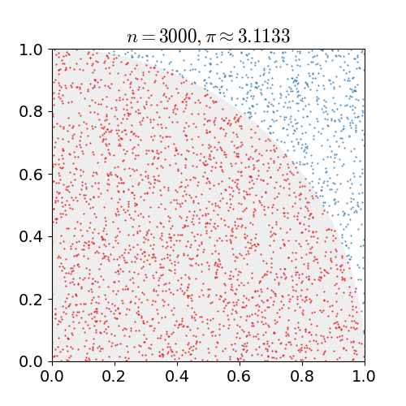
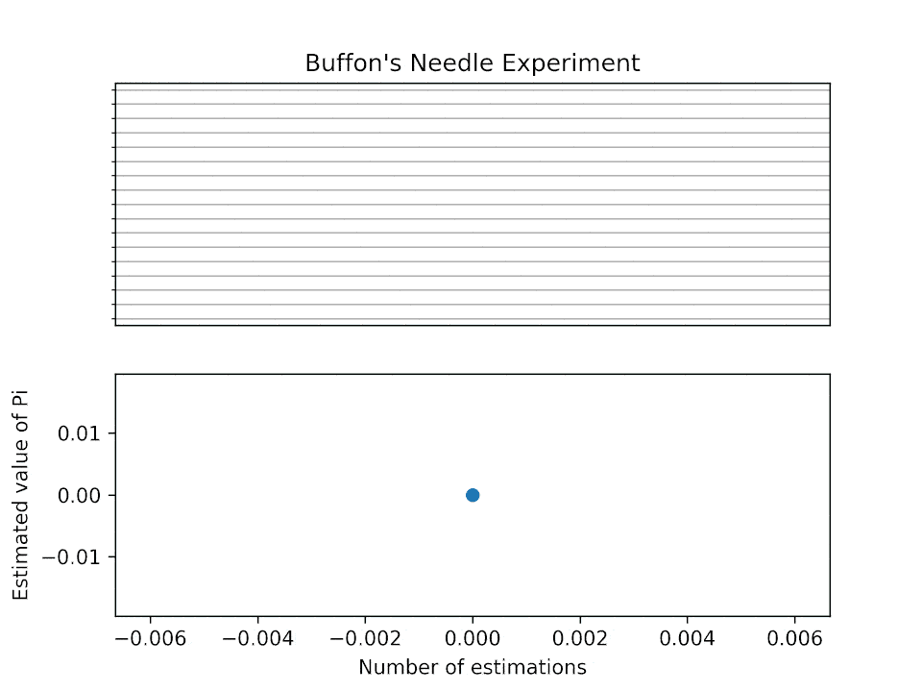
Monte Carlo methods
A family of methods that rely on repeated random sampling to obtain numerical results

Slide 5
Monte Carlo methods
A family of methods that rely on repeated random sampling to obtain numerical results
  Define the input space
  Independently sample from the desired distribution over the input space
  Aggregate the samples for evaluation
key step!

Slide 6
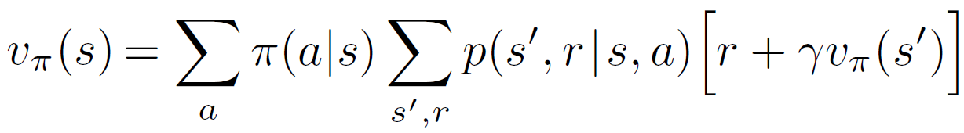

Monte Carlo prediction
Policy evaluation (a.k.a prediction)
  In dynamic programming (therefore, model-based)
All given; but what if the model is not provided?

Slide 7
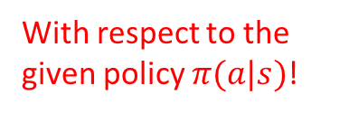
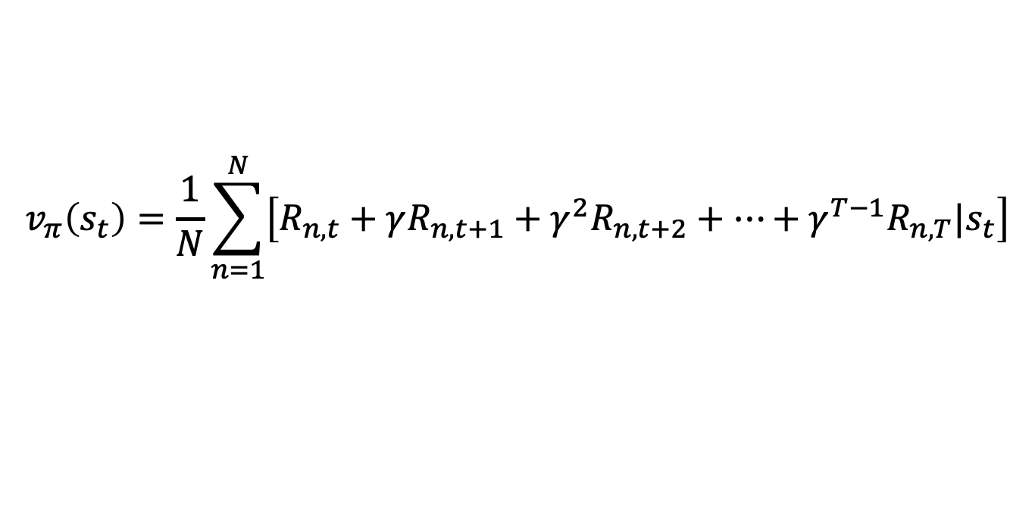
Monte Carlo prediction
Policy evaluation (a.k.a prediction)
  Assume the environment is accessible
    Interact with the environment to get experiences
    Use the experiences to estimate the values
Sampling
Evaluation
$$v_{π}\left(s_{t}\right)=E_{π}\left[R_{t+1}+γR_{t+2}+γ^{2}R_{t+3}+…+γ^{T−1}R_{T}|s_{t}\right]$$
With respect to the given policy $π(a|s)$!
$${{\{s}_{n,t},a_{n,t},R_{n,t},s_{n,t+1},a_{n,t+1},R_{n,t+1},……,s_{n,T},a_{n,T},R_{n,T}\}}_{n=1}^{N}$$
$$v_{π}\left(s_{t}\right)=\frac{1}{N}\sum_{n=1}^{N}{\left[R_{n,t}+γR_{n,t+1}+γ^{2}R_{n,t+2}+…+γ^{T−1}R_{n,T}|s_{t}\right]}$$

Slide 8
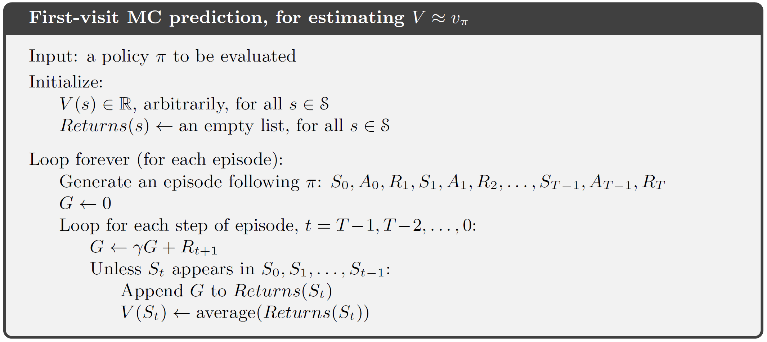
Monte Carlo prediction
To ensure the collected samples are i.i.d
Only for episodic tasks!
?
Move backwards to collect statistics
Update only happens after each episode, not each action!

Slide 9




Monte Carlo prediction
Chernoff-Hoeffding bound
Good properties
  Unbiased estimate of value function
  The estimate’s standard deviation converges with a rate of $o(\frac{1}{\sqrt{N}})$
  Estimating value in a single state is independent from the total number of states

Slide 10
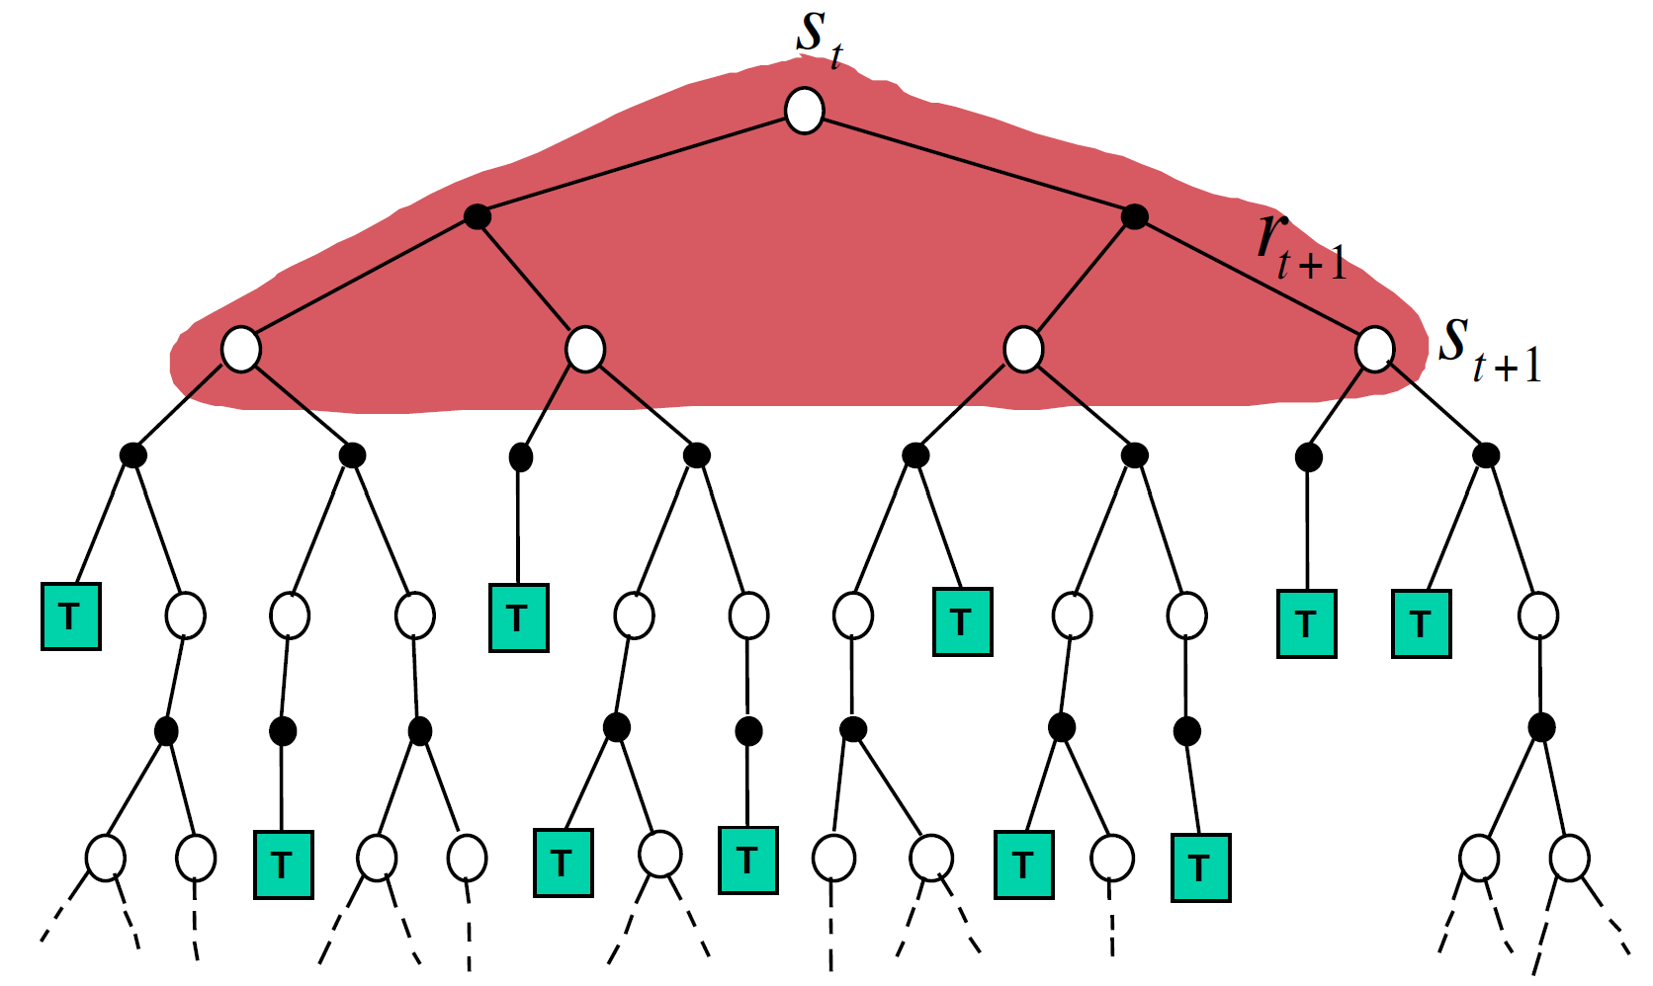
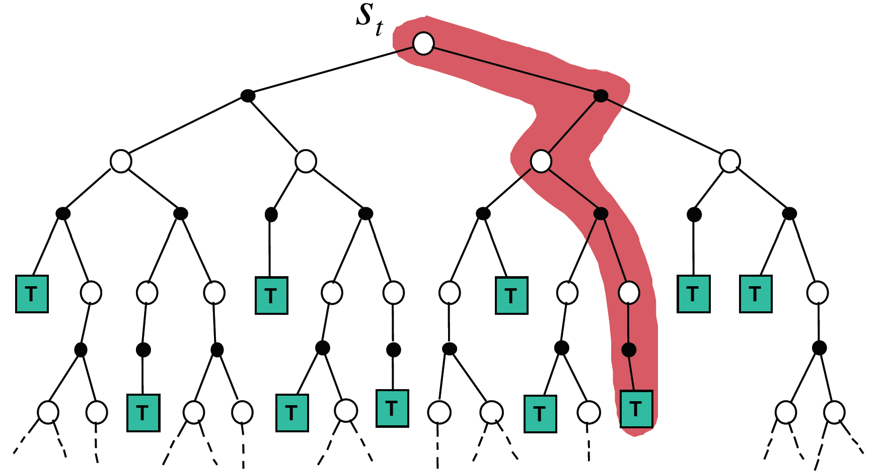
Comparisons
Monte Carlo methods
  Model-free
  Evaluation of one state is independent from evaluation on other states
Dynamic programming
  Model-based
  Evaluation of states depends on each other
Figure credit: David Silver, “Model-Free Prediction”

Slide 11
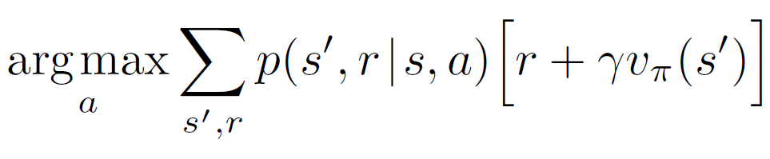











Action value function for control
For policy improvement, state value function alone is insufficient
  Recall in dynamic programming, we need reward of each action and value of next state
$$v\left(g\right)=−2$$
$$v\left(t\right)=0$$
$$v\left(d\right)=−4$$
2
g
2
1
t
b
d
4
$$v\left(b\right)=−5$$
4
2
a
4
9
$$v\left(a\right)=−9$$
$$π^{∗}\left(a\right)=→b$$
f
2
c
e
5
$$v\left(f\right)=−2$$
3
$$v\left(e\right)=−7$$
$$π^{∗}\left(f\right)=→t$$
$$v\left(c\right)=−8$$
$$π^{∗}\left(c\right)=→d$$

Slide 12
State-action value function
It gets complicated when using Monte Carlo methods
  Sample episodes for each state-action pairs
  As estimates are independent from each other, if one pair is never visited before, its estimate will never be updated
    Exploration matters!
  On-policy methods
  Off-policy methods
What we learnt in bandits applies!

Slide 13
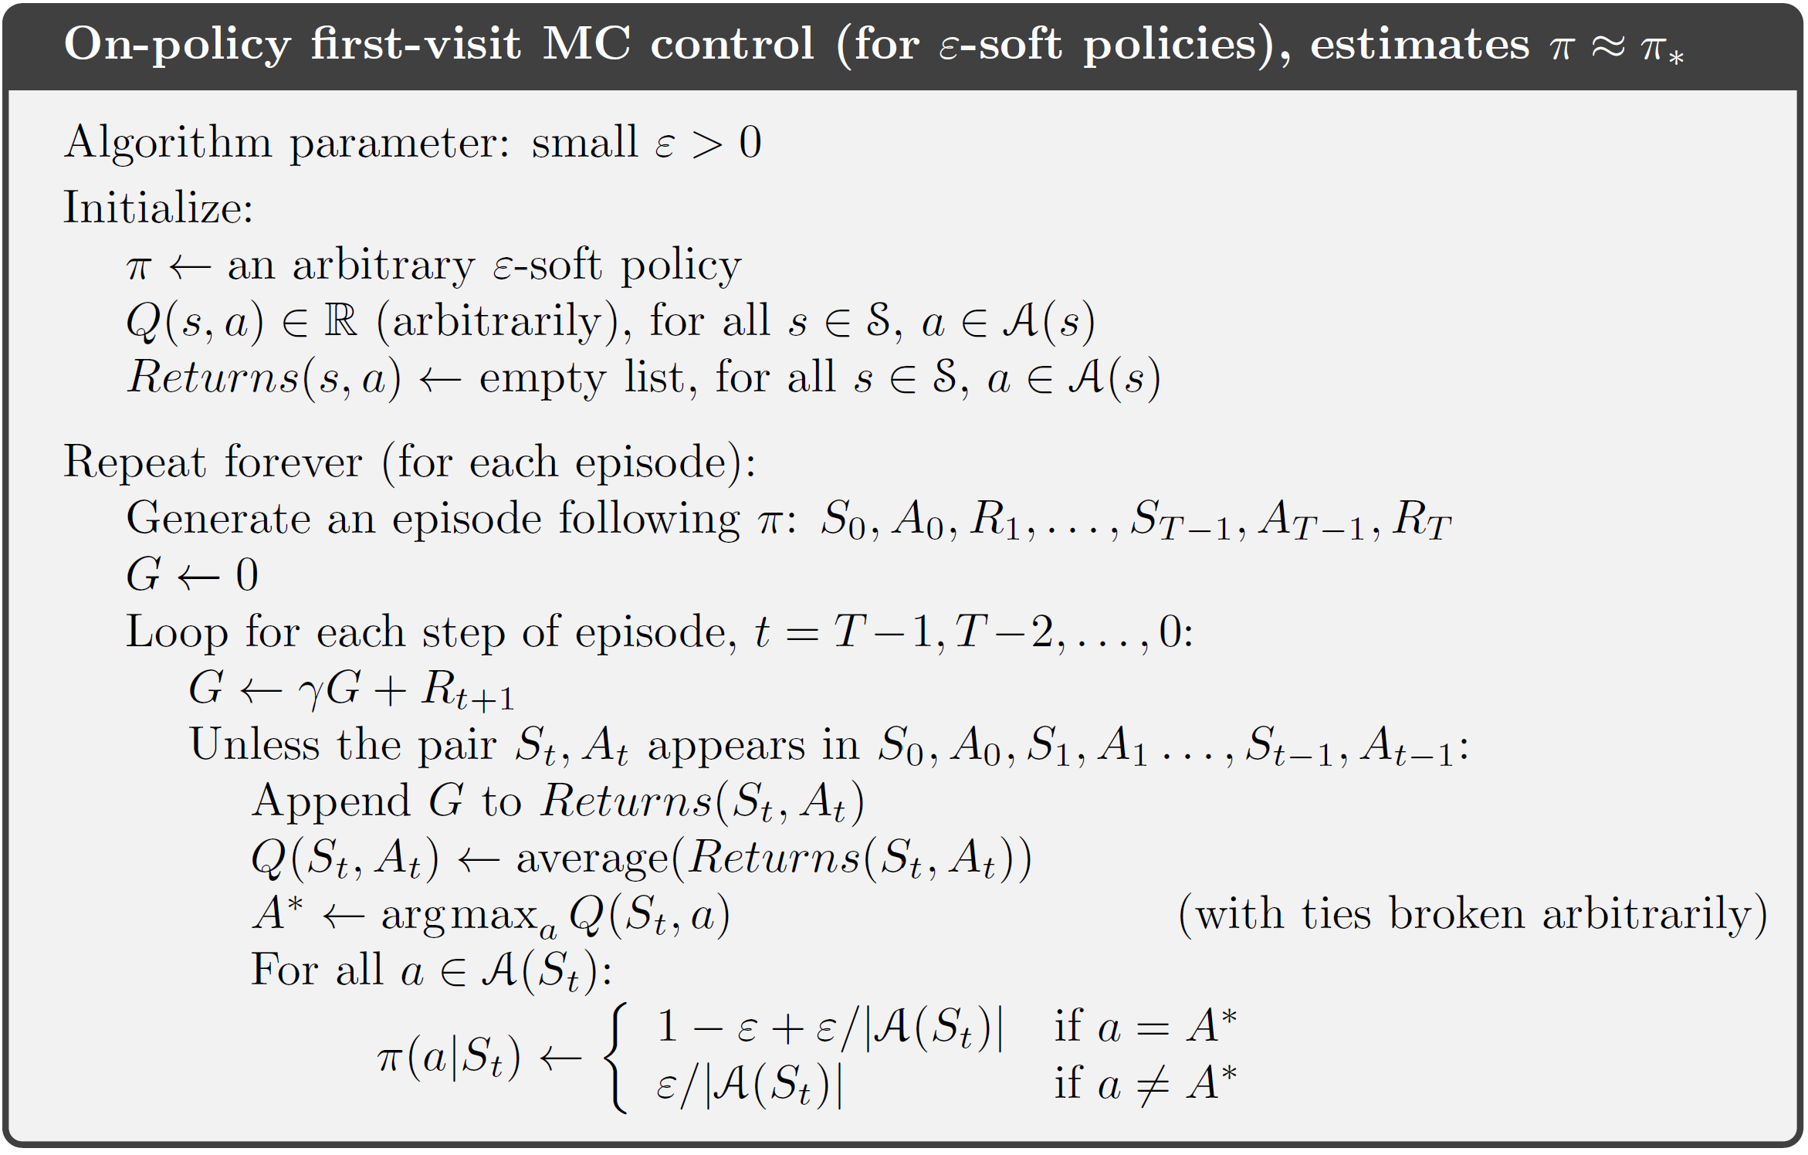


On-Policy MC control
$$π\left(a | s\right)≥\frac{ε}{\left|A\left(s\right)\right|}, ∀s,a$$
All state-action pairs will be taken with a non-zero probability
Can we use UCB here?
$ε$-greedy

Slide 14
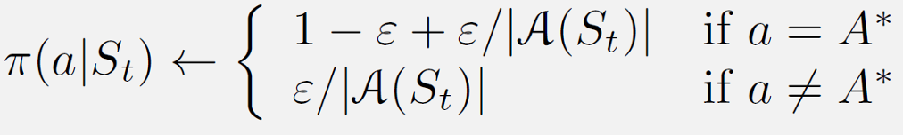
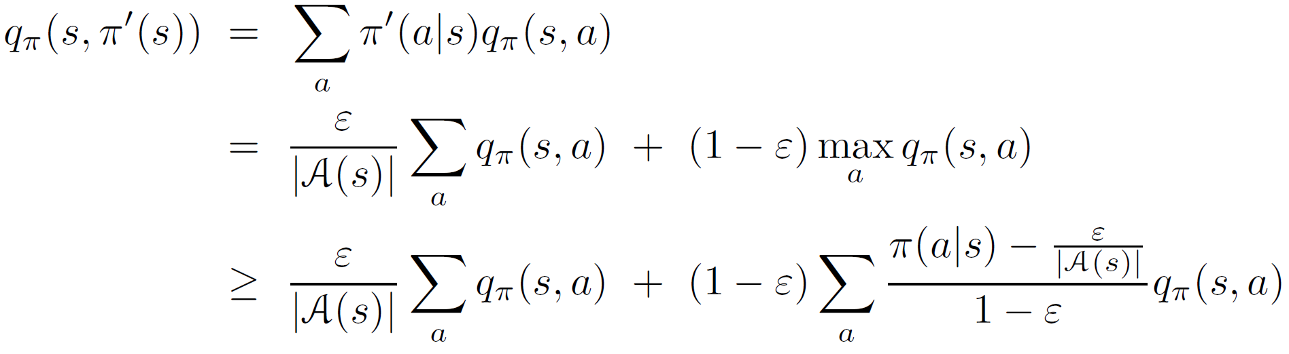
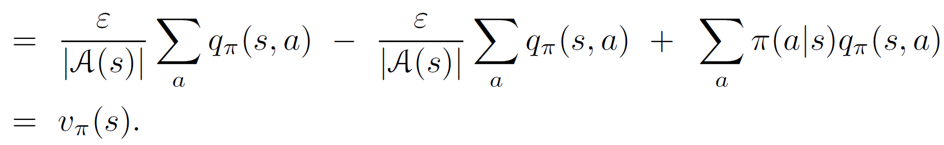
On-Policy MC control
Policy improvement is guaranteed

Slide 15
Recap: Monte Carlo prediction
Policy evaluation (a.k.a prediction)
  Assume the environment is accessible
    Interact with the environment to get experiences
    Use the experiences to estimate the values
Sampling
Evaluation
$$v_{π}\left(s_{t}\right)=E_{π}\left[R_{t+1}+γR_{t+2}+γ^{2}R_{t+3}+…+γ^{T−1}R_{T}|s_{t}\right]$$
With respect to the given policy $π(a|s)$!
$${{\{s}_{n,t},a_{n,t},R_{n,t},s_{n,t+1},a_{n,t+1},R_{n,t+1},……,s_{n,T},a_{n,T},R_{n,T}\}}_{n=1}^{N}$$
$$v_{π}\left(s_{t}\right)=\frac{1}{N}\sum_{n=1}^{N}{\left[R_{n,t}+γR_{n,t+1}+γ^{2}R_{n,t+2}+…+γ^{T−1}R_{n,T}|s_{t}\right]}$$

Slide 16
Recap: on-policy MC control
$$π\left(a | s\right)≥\frac{ε}{\left|A\left(s\right)\right|}, ∀s,a$$
All state-action pairs will be taken with a non-zero probability
Can we use UCB here?
$ε$-greedy

Slide 17
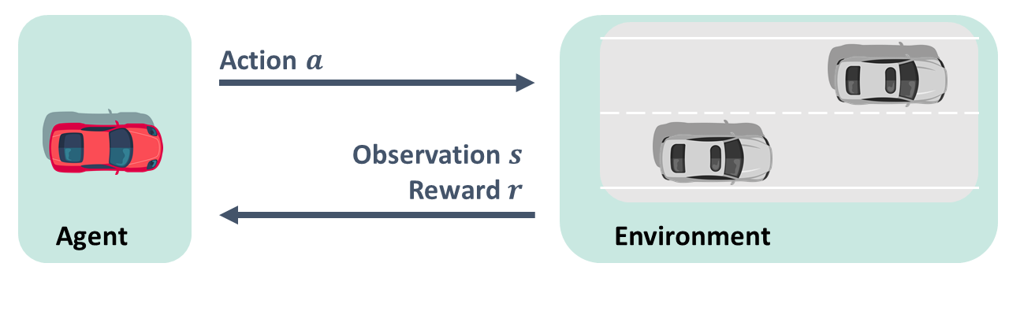
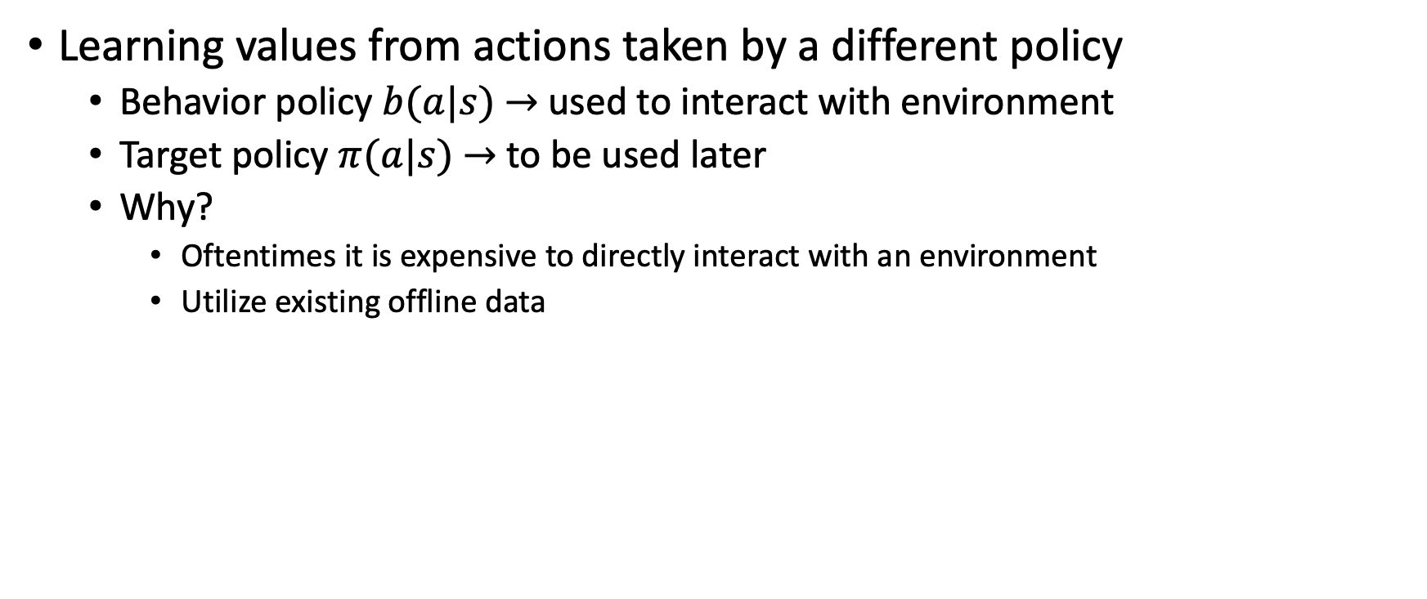


Off-Policy MC control
Learning values from actions taken by a different policy
  Behavior policy $b(a|s)$ $→$ used to interact with environment
  Target policy $π(a|s)$ $→$ to be used later
  Why?
    Oftentimes it is expensive to directly interact with an environment
    Utilize existing offline data
behavior policy $b(a|s)$
target policy $π(a|s)$

Slide 18
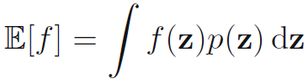
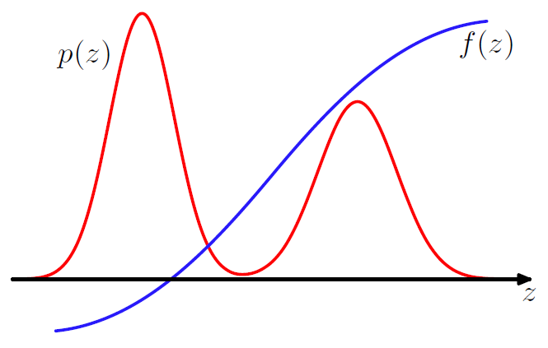
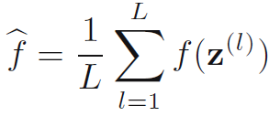

Uniform notion for sampling
Compute expectation
  Basic idea: approximate by a finite sum
Get $\{z^{(l)}\}$ with respect to $p(z)$
How to sample from any arbitrary distributions?
Figure credit: Bishop, “Pattern Recognition and Machine Learning”, 2nd edition, p524

Slide 19
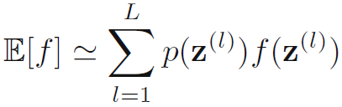
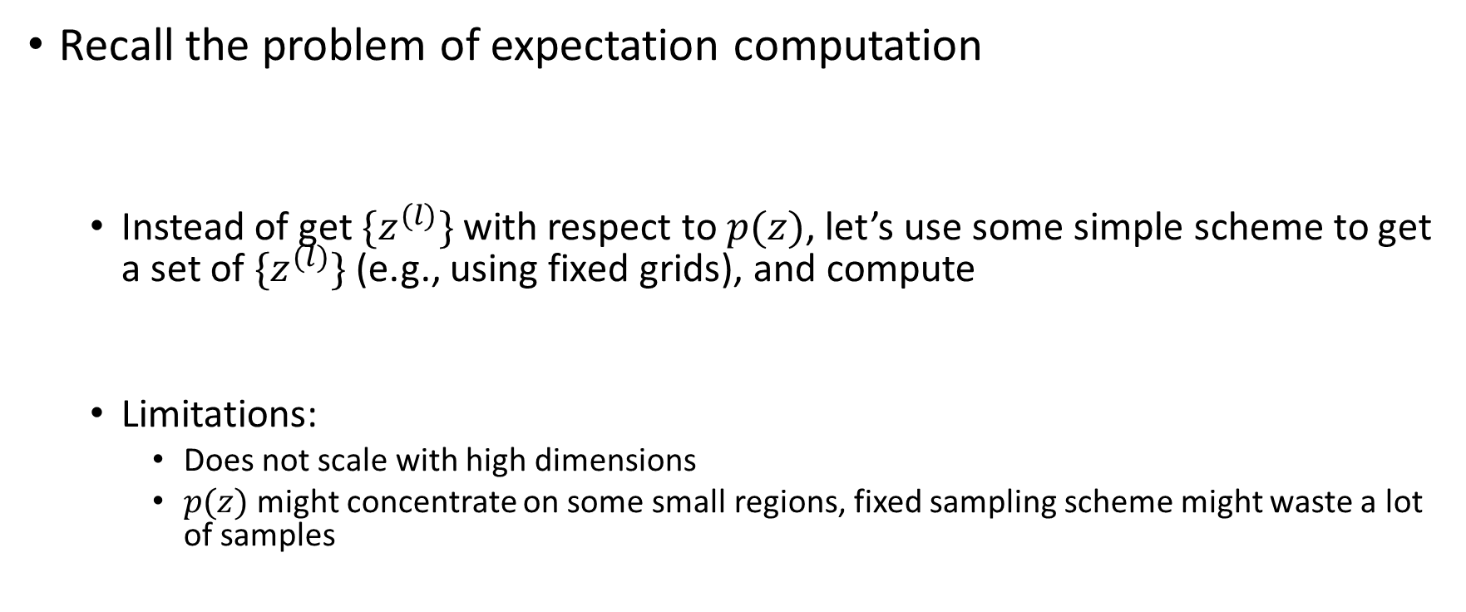
Sampling is not easy
Recall the problem of expectation computation
  Instead of get $\{z^{(l)}\}$ with respect to $p(z)$, let’s use some simple scheme to get a set of $\{z^{(l)}\}$ (e.g., using fixed grids), and compute
  Limitations:
    Does not scale with high dimensions
    $p(z)$ might concentrate on some small regions, fixed sampling scheme might waste a lot of samples

Slide 20
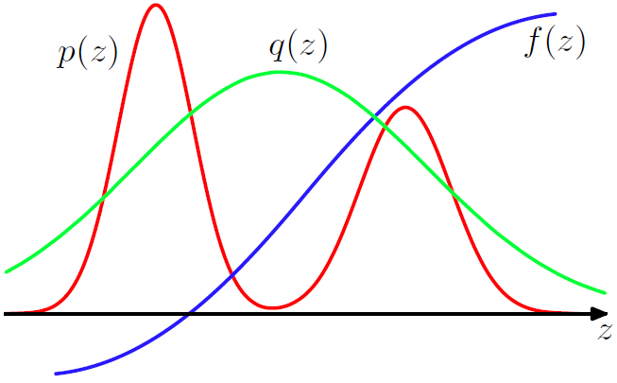
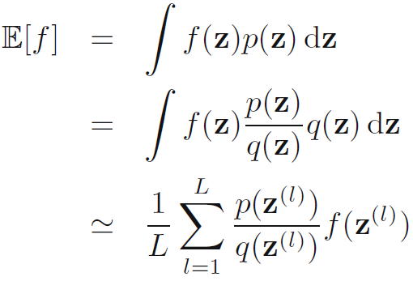
Importance sampling
Let’s sample from a proposal distribution and reweigh its contribution to the expectation
What if we cannot directly evaluate this?
Assumption: both distributions have the same support!
Importance weight

Slide 21




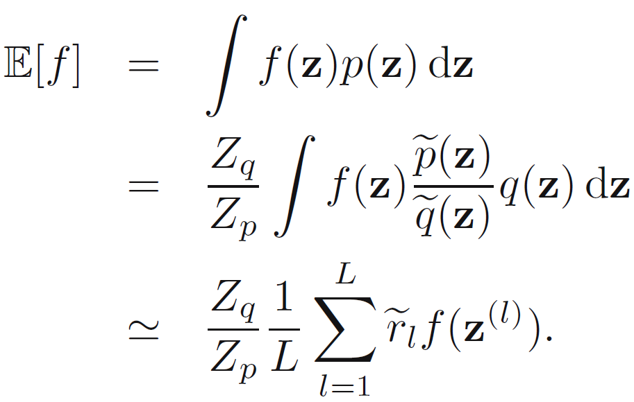
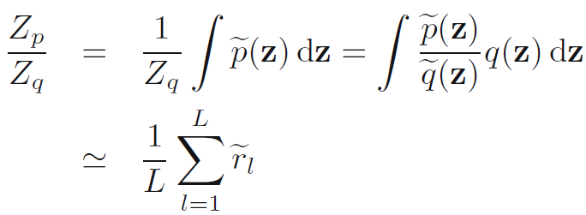
Importance sampling
If we can only evaluate and up to a constant
  and

Slide 22
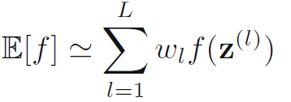
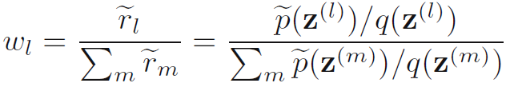
Importance sampling
If we can only evaluate and up to a constant
  and
Proposal distribution still has to be close the target distribution to increase the fidelity of expectation estimation
where,
Weighted importance sampling

Slide 23
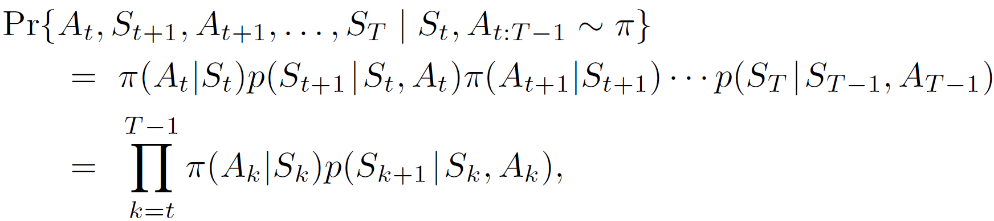
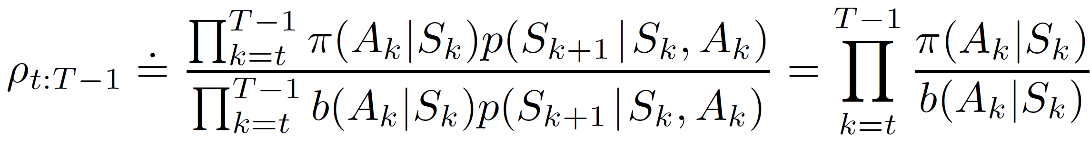
Off-Policy MC evaluation
Use importance sampling to reweigh experiences
  As the environment follows an MDP
  The importance weight is the product of the series of actions under two policies
Source of large variance!

Slide 24
Off-Policy MC evaluation
Use importance sampling to reweigh experiences
  Return of target policy under the behavior policy’s trajectories
By behavior policy!

Slide 25
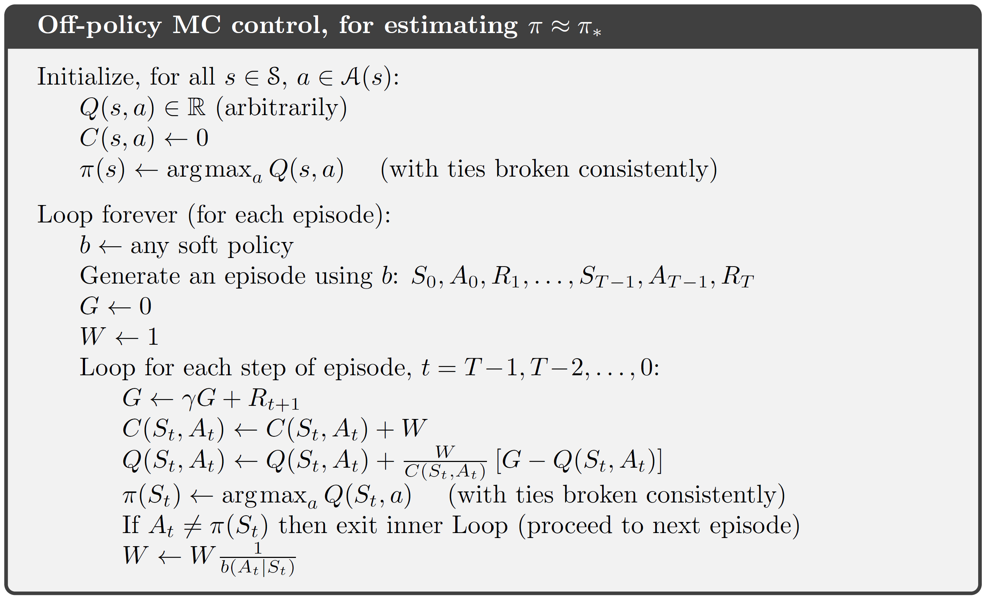
Off-Policy MC control
Incremental update
Why?
Why?

Slide 26
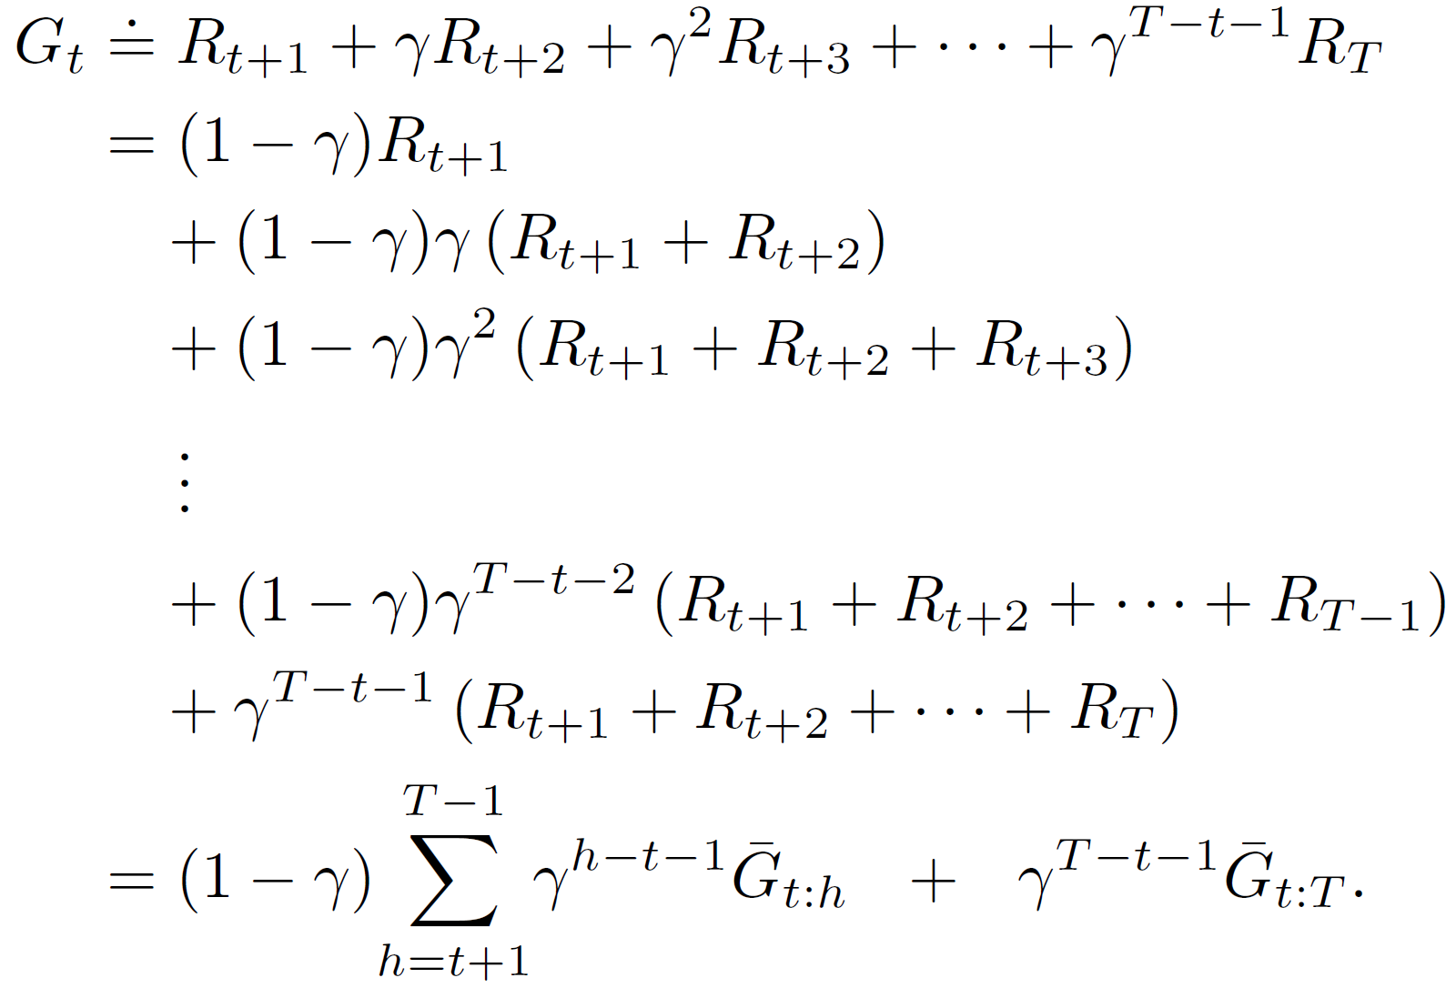

Discounting-aware importance sampling
Direct application of importance sampling causes high variance in value estimation
  Importance weight is a product of a series of probability ratios
  Return is a sum of an exponentially decaying series!
Will be small!
Flat partial return ${\overline{G}}_{t:h}$

Slide 27
Discounting-aware importance sampling
Direct application of importance sampling causes high variance in value estimation
  Importance weight is a product of a series of probability ratios
  Return is a sum of an exponentially decaying series!
  Using the exponentially (small) discounting factor to balance the exponentially (large) importance weight
strike a balance

Slide 28
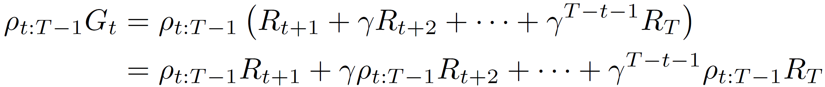
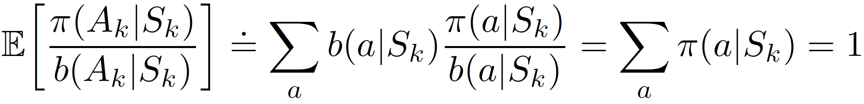
Per-decision importance sampling
The same importance weight for every action in an episode?
  A closer look
Under behavior policy

Slide 29
Per-decision importance sampling
The importance weight only needs to be counted till the current action
  Apply it to reweigh return
The subsequent actions do not affect the reward of this step!
strike a balance
A much shorter series to compute product

Slide 30
Takeaways
A model-free RL solution
  Learns from experiences
Monte Carlo control is based on generalized policy iteration in an episode-by-episode basis
On-policy Monte Carlo methods
  Exploration matters
Off-policy Monte Carlo methods
  Variance control matters

Slide 31
Suggested readings
Chapter 5, Monte Carlo Methods
Bishop, “Pattern Recognition and Machine Learning”, 2nd edition, Chapter 11, Sampling Methods

